Slide 1

Text Summarization for Daily Mail and CNN Articles
NLP Final Project- Group 3

Slide 2
Types of Summarization
Extractive Summarization (ES):
Extract the most relevant information from a document
Context is not taken into consideration and is verbatim text.
Abstractive Summarization (AS):
Generate new text that captures the most relevant information
Context is taken into consideration, compressed paraphrasing of the main contents of the document, potentially using vocabulary unseen in the source document

Slide 3

Idea
https://www.inshorts.com/

Slide 4

News Article
https://www.dailymail.co.uk/news/article-2209497/David-Cameron-goes-way-Brazil-drum-business-just-want-talk-Boris.html

Slide 5
Don’t have time to read the full article? Worry Not!
Transformers to the rescue

Slide 6

Transformers

Slide 7



Transformers
BART
T5 (Text-to-Text)
GPT-2

Slide 8
BART (Bidirectional Auto-Regressive Transformers)
Facebook AI research combined Google's BERT and Open Ai's GPT
A denoising autoencoder for pretraining sequence-to-sequence models and uses a standard Transformer-based neural machine translation architecture.
Uses a standard seq2seq/NMT architecture with a bidirectional encoder (like BERT) and a left-to-right decoder (like GPT). This means the encoder's attention mask is fully visible, like BERT, and the decoder's attention mask is causal, like GPT2.
Trained by
corrupting text with an arbitrary noising function
learning a model to reconstruct the original text.

Slide 9
T5 (Text-to-Text Transfer Transformer)
Yes – Google created it
Transformer based architecture that uses a text-to-text approach
Every task – including translation, question answering, and classification – is cast as feeding the model text as input and training it to generate some target text
The changes compared to BERT include:
adding a causal decoder to the bidirectional architecture.
replacing the fill-in-the-blank cloze task with a mix of alternative pre-training tasks

Slide 10
GPT-2 (Generative Pre-Training Transformer)
OpenAI GPT-2 model was proposed in Language Models are Unsupervised Multitask Learners
Causal (unidirectional) transformer pretrained using language modeling on a very large corpus of ~40 GB of text data
GPT-2 is trained with a simple objective: predict the next word, given all of the previous words within some text.
GPT-2 is a model with absolute position embeddings, so it’s usually advised to pad the inputs on the right rather than the left.

Slide 11
Metrics Used
ROUGE (Recall-Oriented Understudy for Gisting Evaluation):
A metric used for evaluating automatic summarization and machine translation software in natural language processing
Compares an automatically produced summary or translation against a reference or a set of references (human-produced) summary or translation.
Case insensitive, meaning that upper case letters are treated the same way as lower-case letters
BLEU (Bi-Lingual Evaluation Understudy):
Algorithm for evaluating the quality of text which has been machine-translated from one natural language to another
One of the first metrics to claim a high correlation with human judgements of quality and remains one of the most popular automated and inexpensive metrics.
Output is always a number between 0 and 1. This value indicates how similar the candidate text is to the reference texts, with values closer to 1 representing more similar texts.

Slide 12

Data Overview

Slide 13
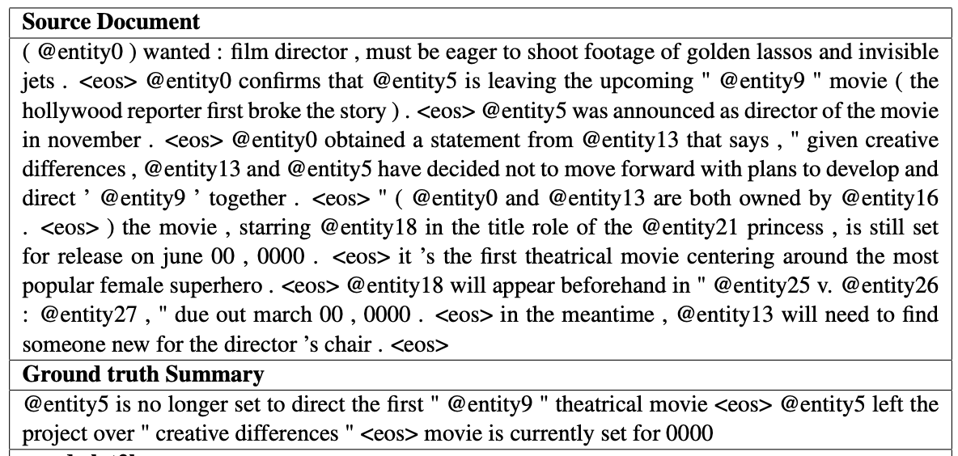
Source: https://cs.nyu.edu/~kcho/DMQA/
In all, the corpus has 200K Daily Mail and 100K CNN articles, as defined by their scripts.
The source documents in the training set have 766 words spanning 29.74 sentences on an average while the summaries consist of 53 words and 3.72 sentences.
The dataset is inspired from the one used in the Association for Computational Linguistics (ACL) 2017 paper Get To The Point: Summarization with Pointer-Generator Networks.
Using Daily Mail to train and build a model.
Using CNN as a test corpus to evaluate Daily Mail model

Slide 14



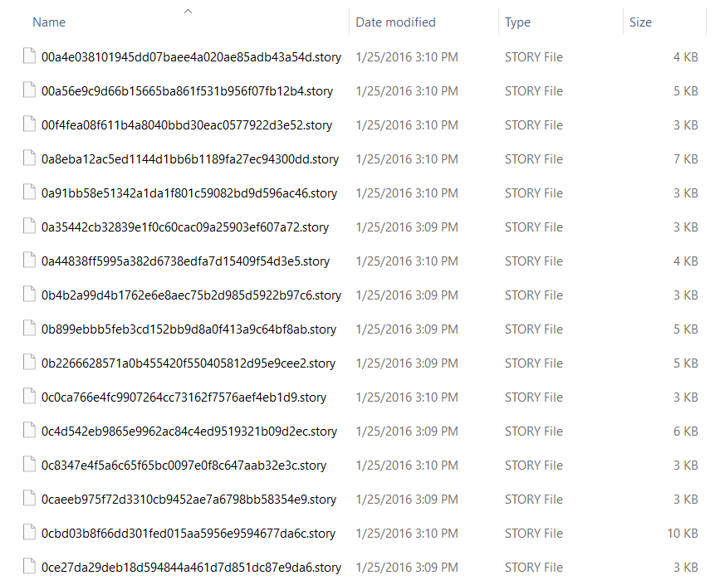
Preprocessing
Remove special characters
Handle contractions
Clean Hashtags
Remove Multiple Spaces
Remove punctuations, links, mentions and \r\n new line characters

Slide 15
Fine-tuning Transformers
Applying similar learning rate to all layers of the model.
Warm-up steps: With training steps in a linear schedule, the learning rates increase linearly from 0 to the initial learning rates set in the optimizer during the warm-up phase
Frequent evaluation on our Transformer fine-tuning process. Instead of validating once on each batch, we are validating for every x epoch of training data.
Other available techniques:
Layer-wise Learning Rate Decay (LLRD). The main idea behind LLRD is to have different learning rates applied to each layer of the Transformer or applied to the grouping of layers in the case of grouped LLRD

Slide 16
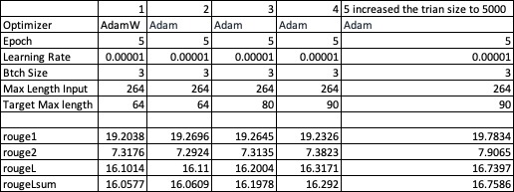
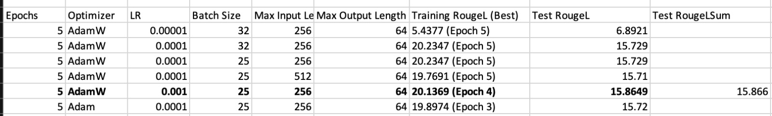
Fine-Tuning – Configuration Tracker
BART
T5

Slide 17
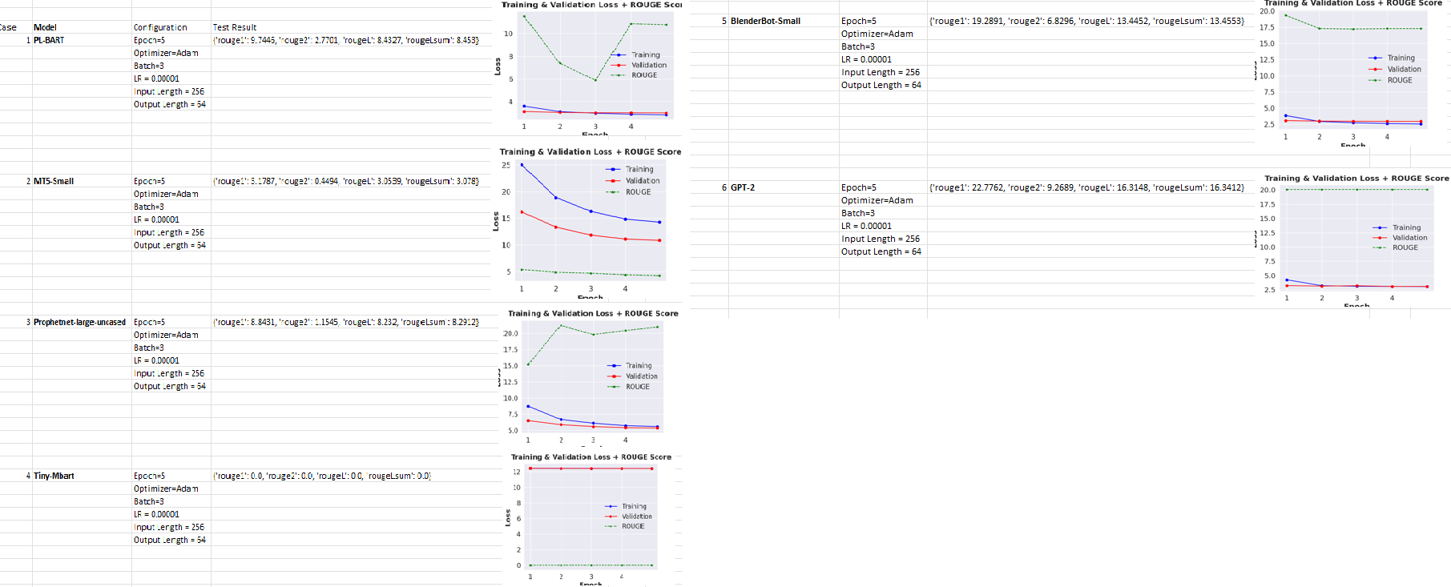
Fine-Tuning.. (contd.)

Slide 18

Results
Loss/ROUGE Scores

Slide 19
BART
Test ROUGE Score: {'rouge1': 21.025, 'rouge2': 8.5661, 'rougeL': 17.8141, 'rougeLsum': 17.8189}

Slide 20
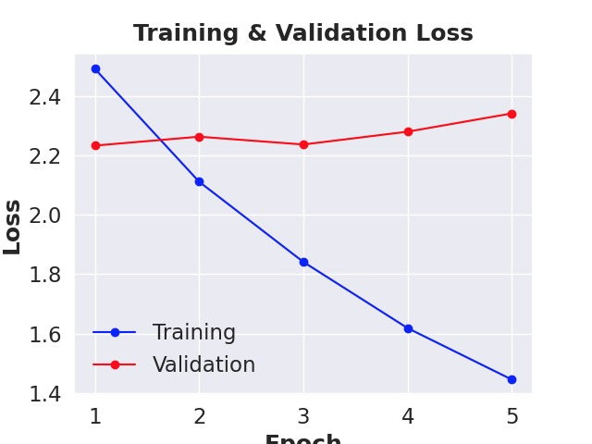
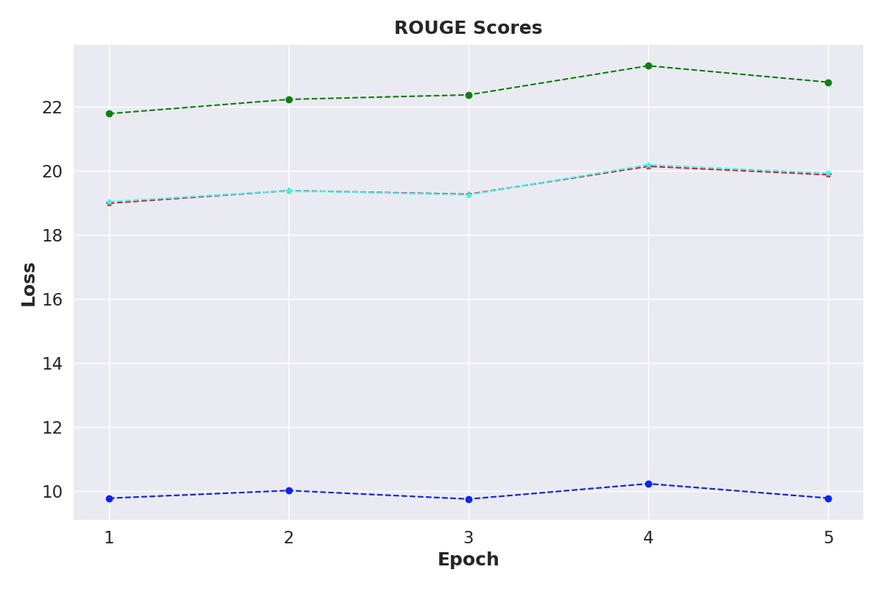
T5
Test ROUGE Score: {'rouge1': 18.4964, 'rouge2': 6.7465, 'rougeL’: 16.6649, 'rougeLsum’: 16.8667}

Slide 21
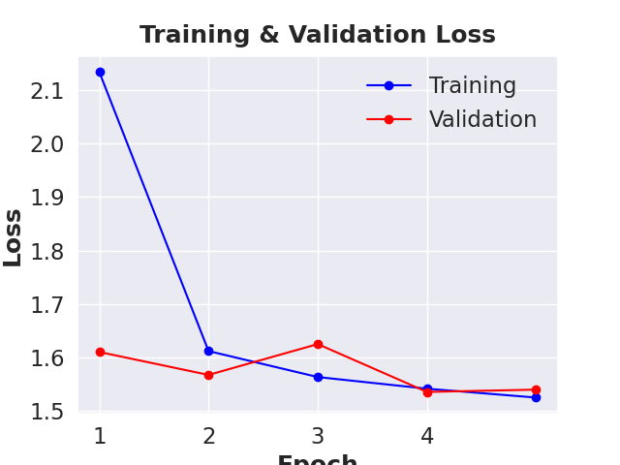
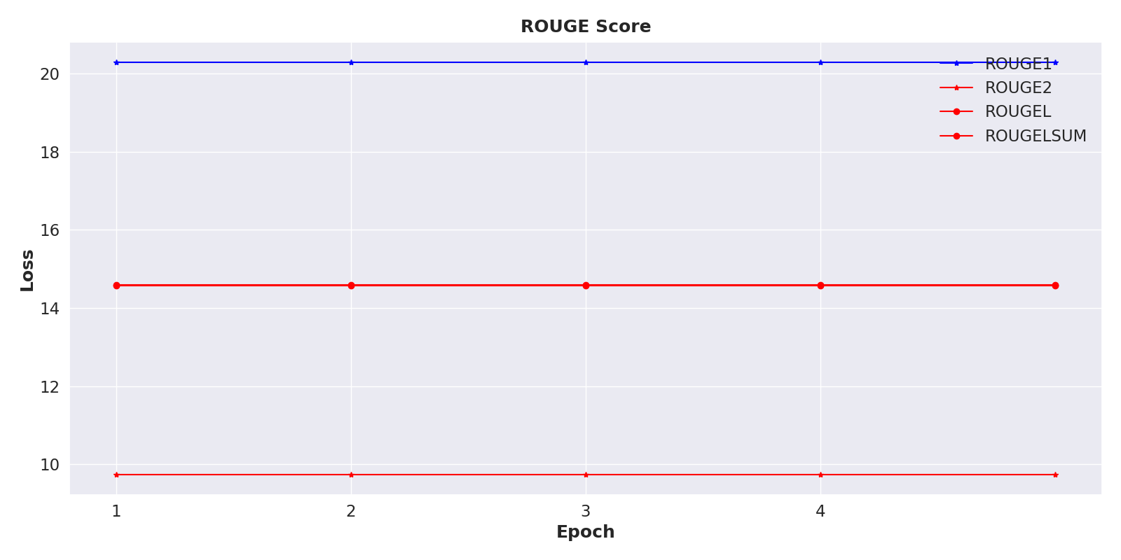
GPT-2
Test ROUGE Score: {'rouge1': 17.0593, 'rouge2': 7.304, 'rougeL': 12.3064, 'rougeLsum': 12.3045}

Slide 22
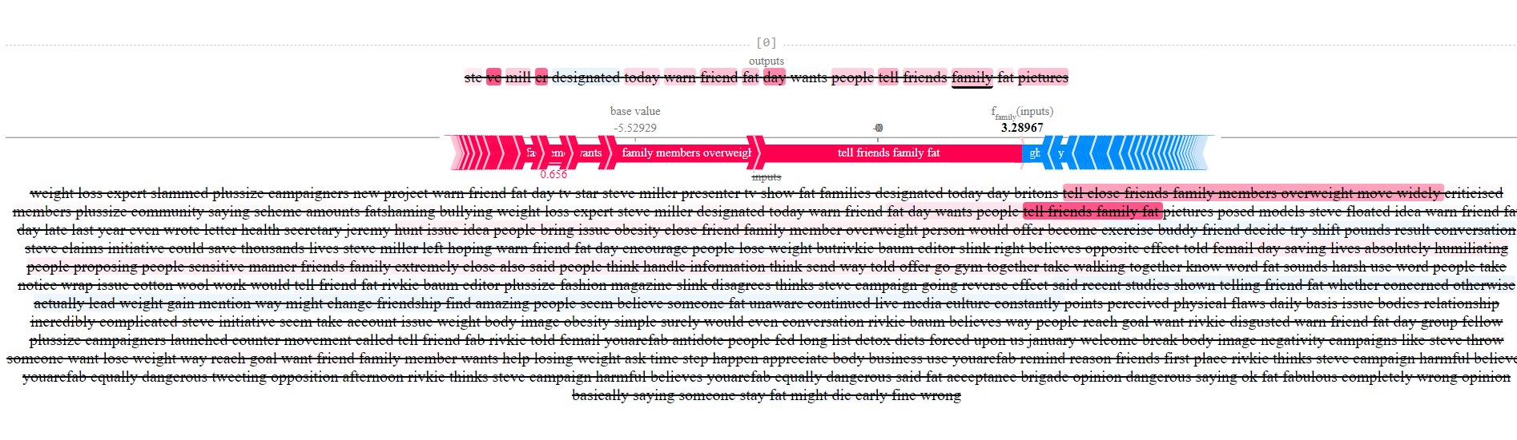
Results – SHAP Explainer

Slide 23
Result - Summarization
Original Text | Predicted Summary
(CNN) -- Interior Department officials announced an extensive restructuring of the agencies that oversee offshore oil drilling Wednesday, pledging "fundamental change" for a system widely criticized after the worst oil spill in U.S. history. The expected moves split the since-renamed Minerals Management Service into separate agencies, with one responsible for approving offshore leases and another to enforce safety and environmental laws. Michael Bromwich, the head of the current Bureau of Ocean Energy Management, Regulation, and Enforcement, told reporters the reorganization is aimed at beefing up safety after "decades of neglect" and conflicts of interest among regulators. "This reorganization is much more than just moving boxes around," Bromwich said. "It is about a comprehensive review and a fundamental change in the way that these agencies operate.“ The Interior Department said it plans to have its newly created Bureau of Ocean Energy Management and Bureau of Safety and Environmental Enforcement up and running by October 1. A separate agency to collect revenues from leases was spun off from MMS in 2010………………….. | T5: the interior department announces an extensive restructuring of the agencies that oversee offshore oil drilling. the agency is split into separate agencies, with one responsible for approving offshore leases and another to enforce safety and environmental laws. the reorganization is aimed at beefing up safety after "decades of neglect" and conflicts of interest among regulators. BART: 'Former head of Sandia National Laboratories to lead committee on safety, well containment. "This reorganization is much more than just moving boxes around," Michael Bromwich says. Minerals Management Service will be split into separate agencies. The agency is responsible for approving offshore leases and enforcing safety and environmental laws.'

Slide 24
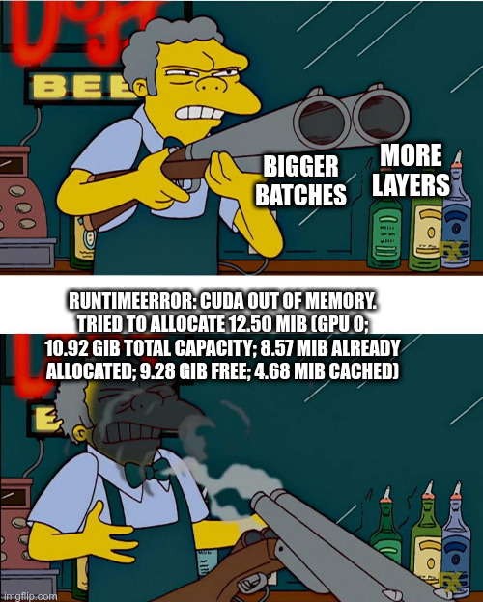
CUDA Error: Out of Memory

